Slide 1
معرفی Visual paradigm
عرفان رفیعی اسکویی - 98243027

Slide 2
بر اساس سایت visual paradigm اسلاید ها را دسته بندی کردیم و هر بخش با توضیحات متناظر آن آمده :

Slide 3
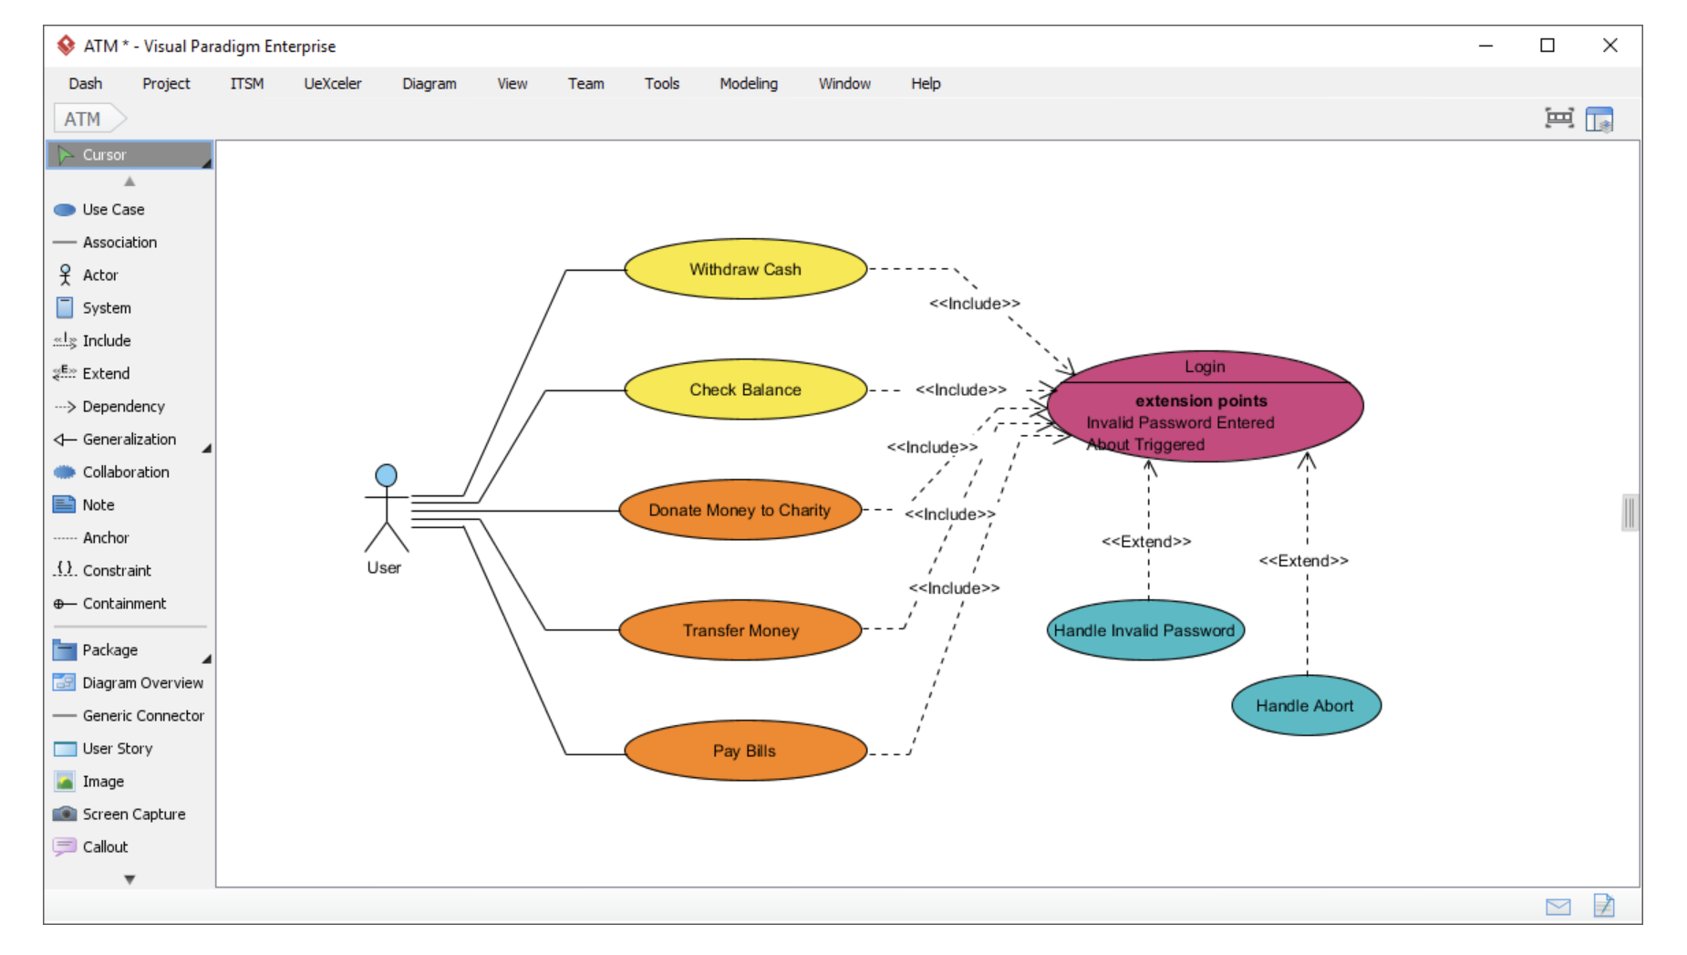
Use Case Diagram Capture functional requirements with UML use case diagram tool. Each use case in a use case diagram represents a high level business goal that yields a measurable result of business values. (UML) Actors are connected with use cases to represent the roles that interact with the functions.

Slide 4
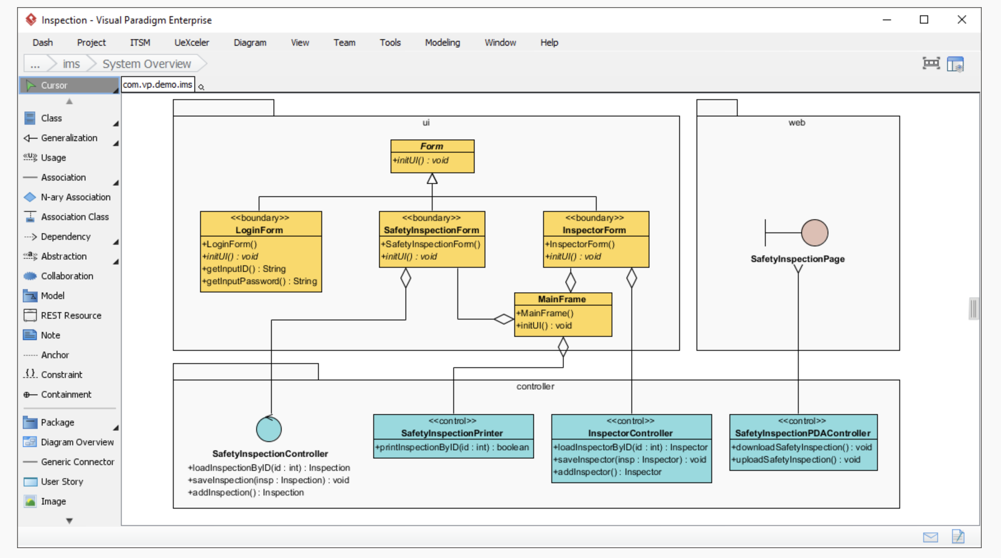
Class Diagram The UML modeling tool lets you model the structure of system by modeling its classes, their attributes and operations in a UML class diagram. UML class diagram is a blueprint of the classes (code level) required to build a software system. Programmers implement a software system with the help of both the class diagram and the class specification.

Slide 5
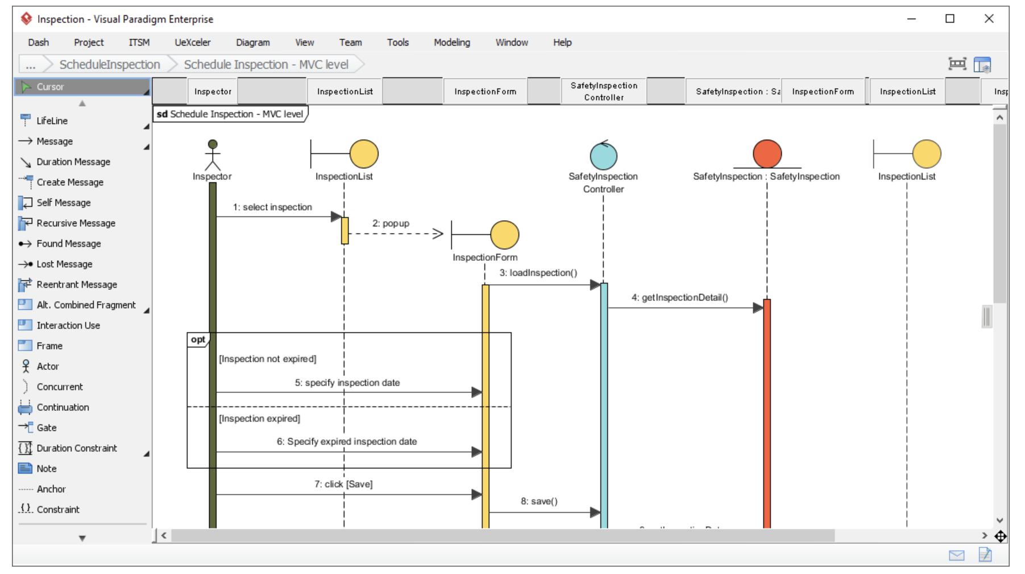
Sequence Diagram Visualize the interactions between users, systems and sub-systems over time through message passing between objects or roles. If class diagram represents the skeleton of classes by showing their attributes and methods, UML sequence diagram complete the classes by representing the programming logic to be filled in methods body.

Slide 6
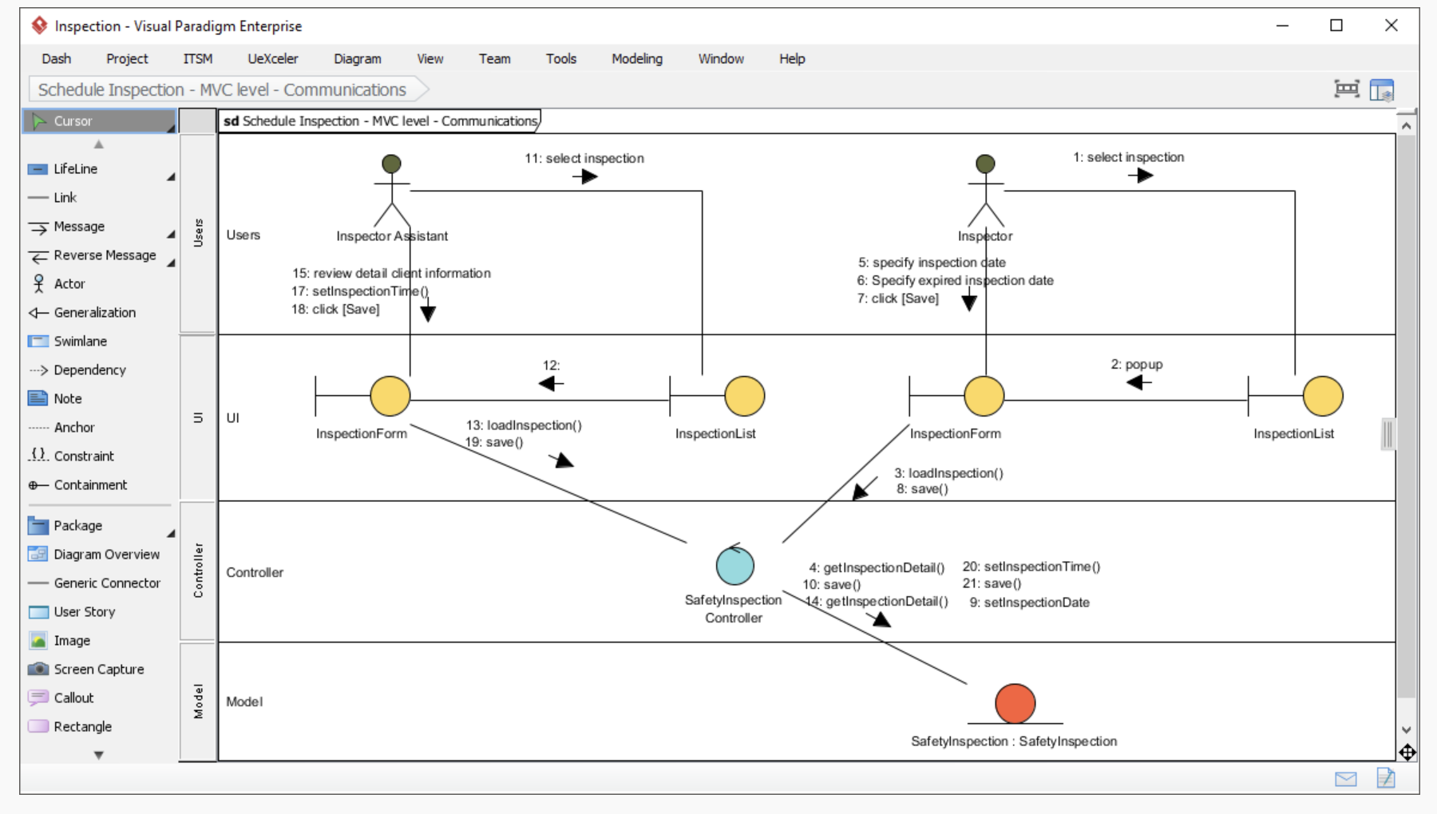
Communication Diagram Collaboration between objects in runtime can be modeled in the UML tool, with a UML communication diagram. In a communication diagram, objects, called lifelines, are connected to represent the need of communication during the execution of an interaction. Messages can be added on top of the connectors to list the calls made from and to those lifelines.

Slide 7
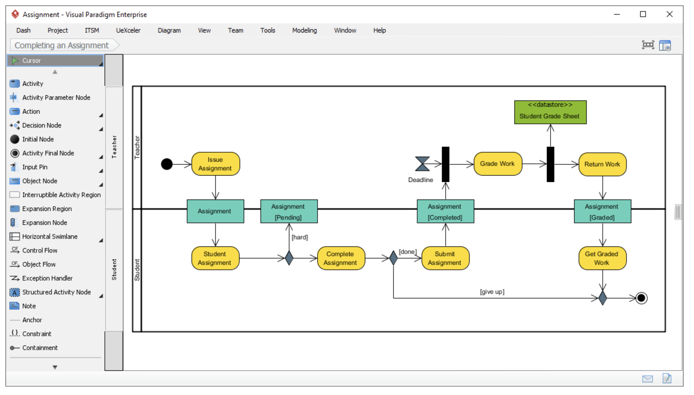
Activity Diagram Use UML activity diagram, a flowchart-based diagram to model the flow of control. Partition actions according to the type of participant involved.

Slide 8
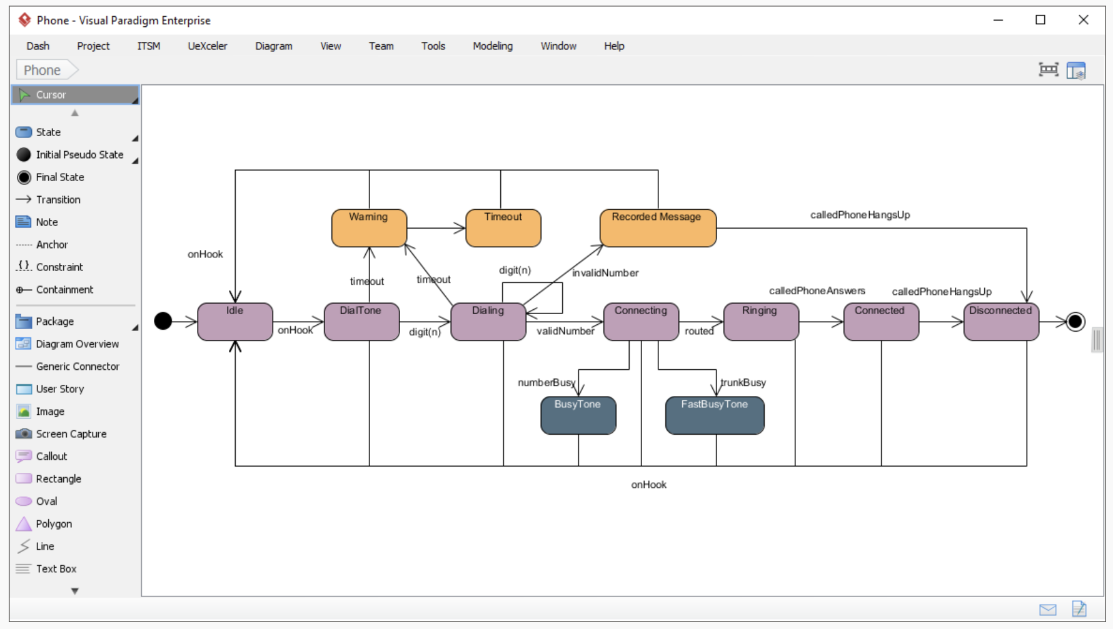
State Machine Diagram State machine diagram is a critical design model for event-driven systems. Well-designed state machine shows accurately the essential states of objects as well as the triggers of state change, which facilitates the development of error-free state machine.

Slide 9
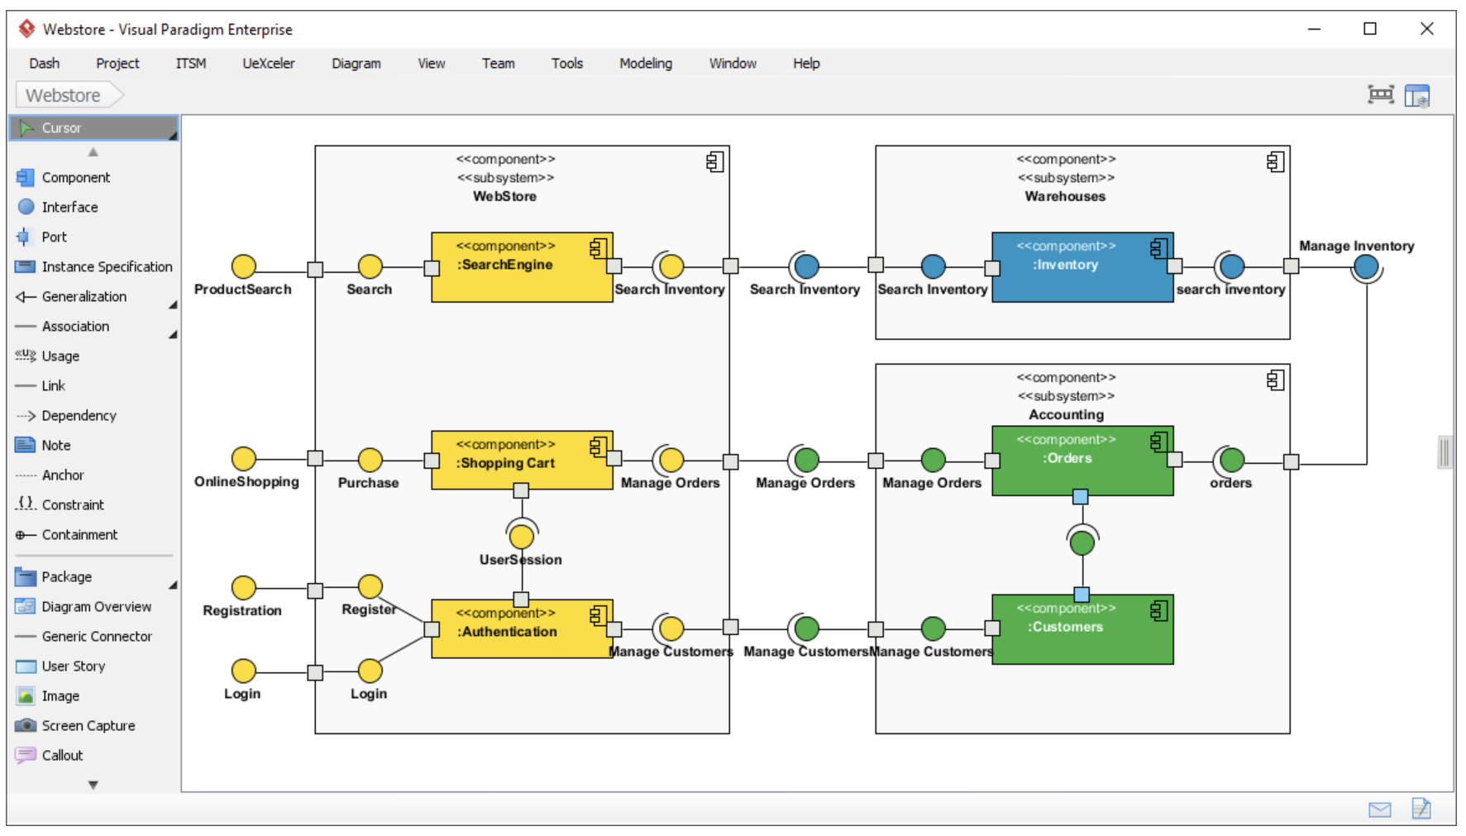
Component Diagram Components diagrams are used to model the structure of systems by showing how little parts of the system gear up in forming a bigger part, or forming the entire software systems.

Slide 10
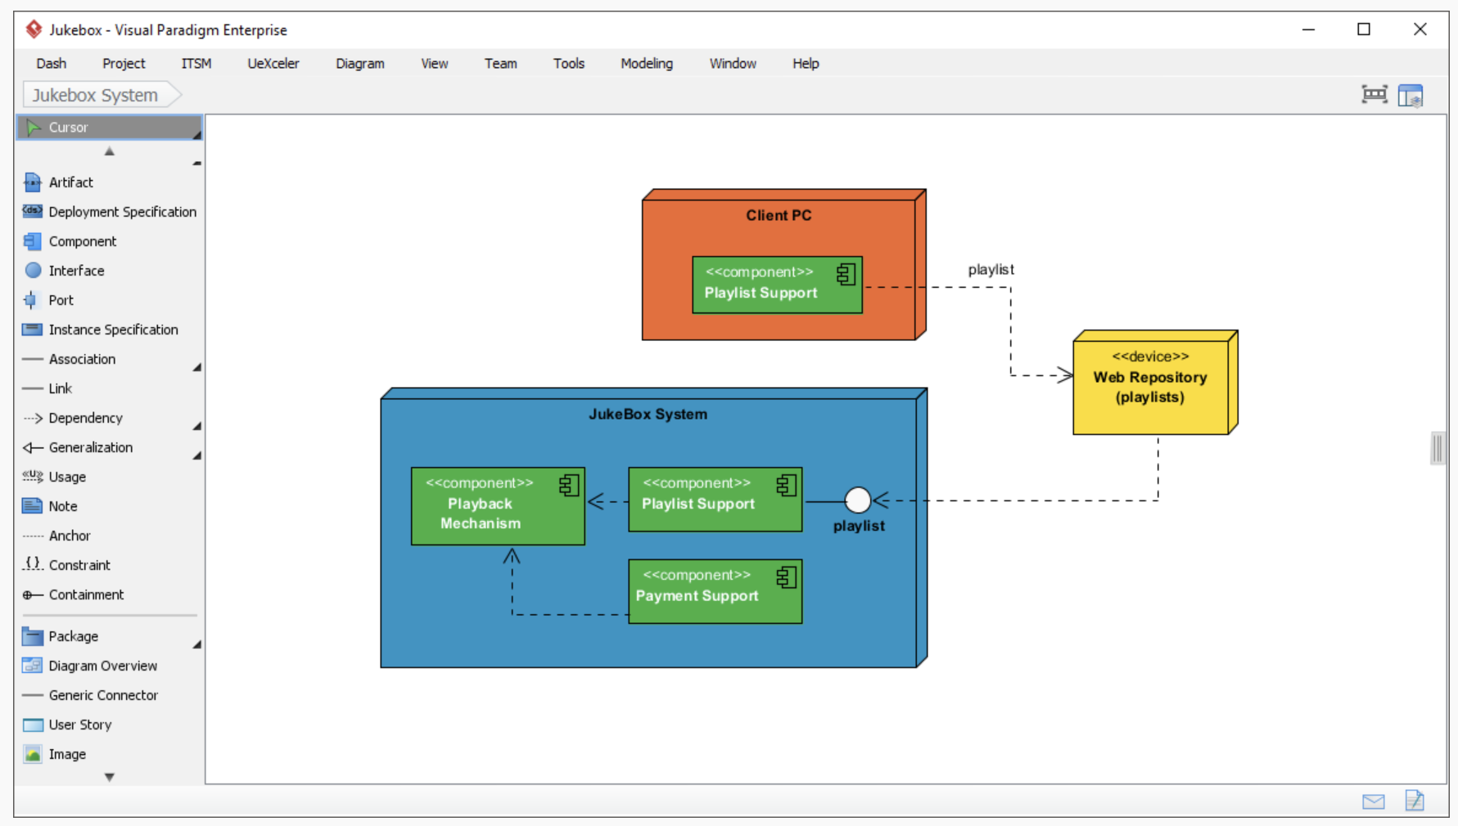
Deployment Diagram Models the physical deployment of software components with UML deployment diagram. In deployment diagram, hardware components (e.g. web server, mail server, application server) are presented as nodes, with the software components that run inside the hardware components presented as artifacts.

Slide 11
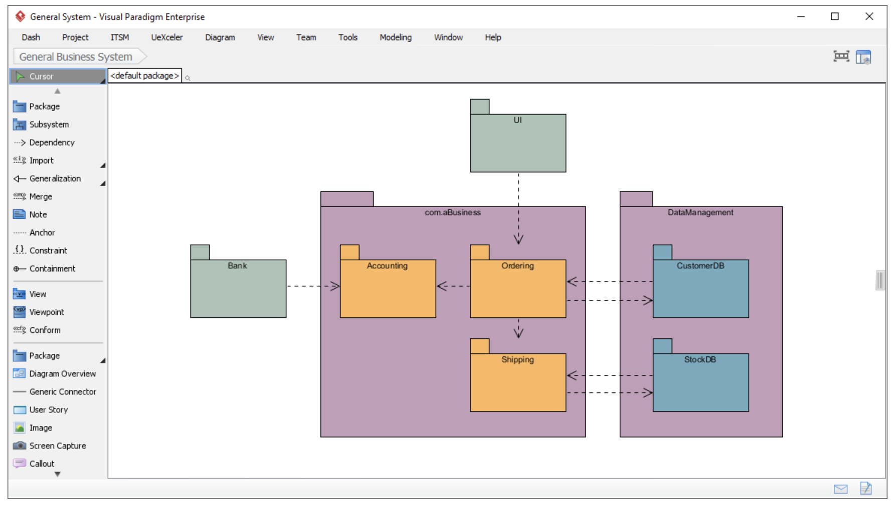
Package Diagram Arrange and organize model for large-scale project with package diagrams. Package diagram is also good in visualizing structure and dependency between sub-systems or modules.

Slide 12
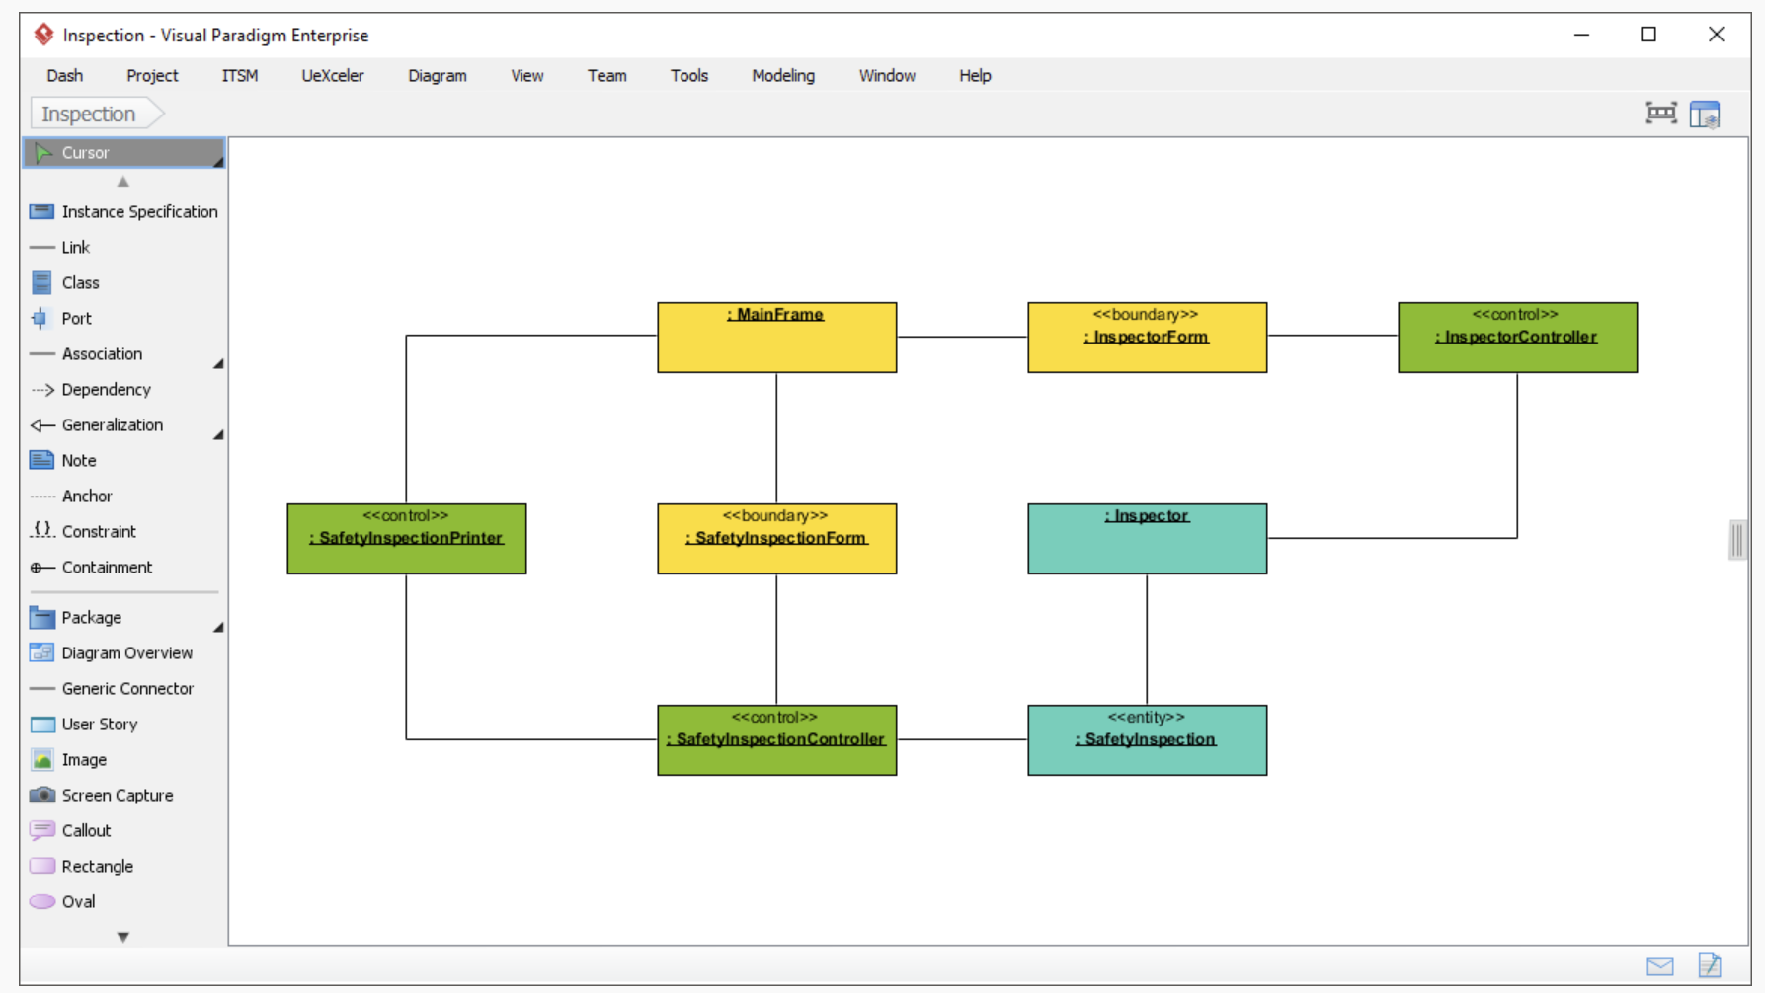
Object Diagram View a snapshot of instances of classifiers in UML class diagrams. Similar to class diagrams, object diagrams show the static design of a system from a prototypical perspective.

Slide 13
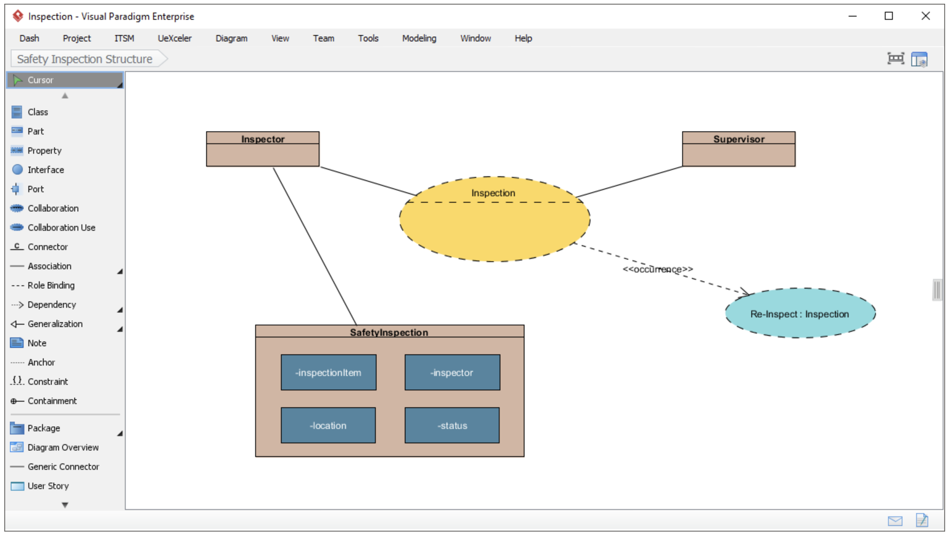
Composite Structure Diagram Visualize the internal structure of a class or collaboration with UML composite structure diagram. Model a system from a micro point-of-view using UML composite structure diagram.

Slide 14
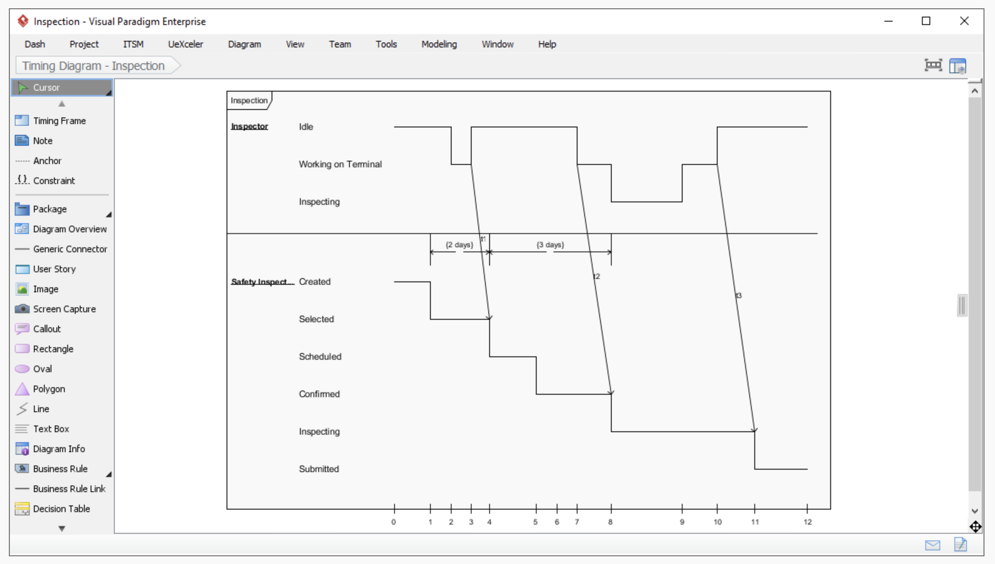
Timing Diagram Timing diagrams model the behavior of objects throughout a given period of time. It is a commonly used UML tool for designing real-time and distributed systems. Just drag to move a time unit back and forth. Have a timing frame updated automatically according to your change.

Slide 15
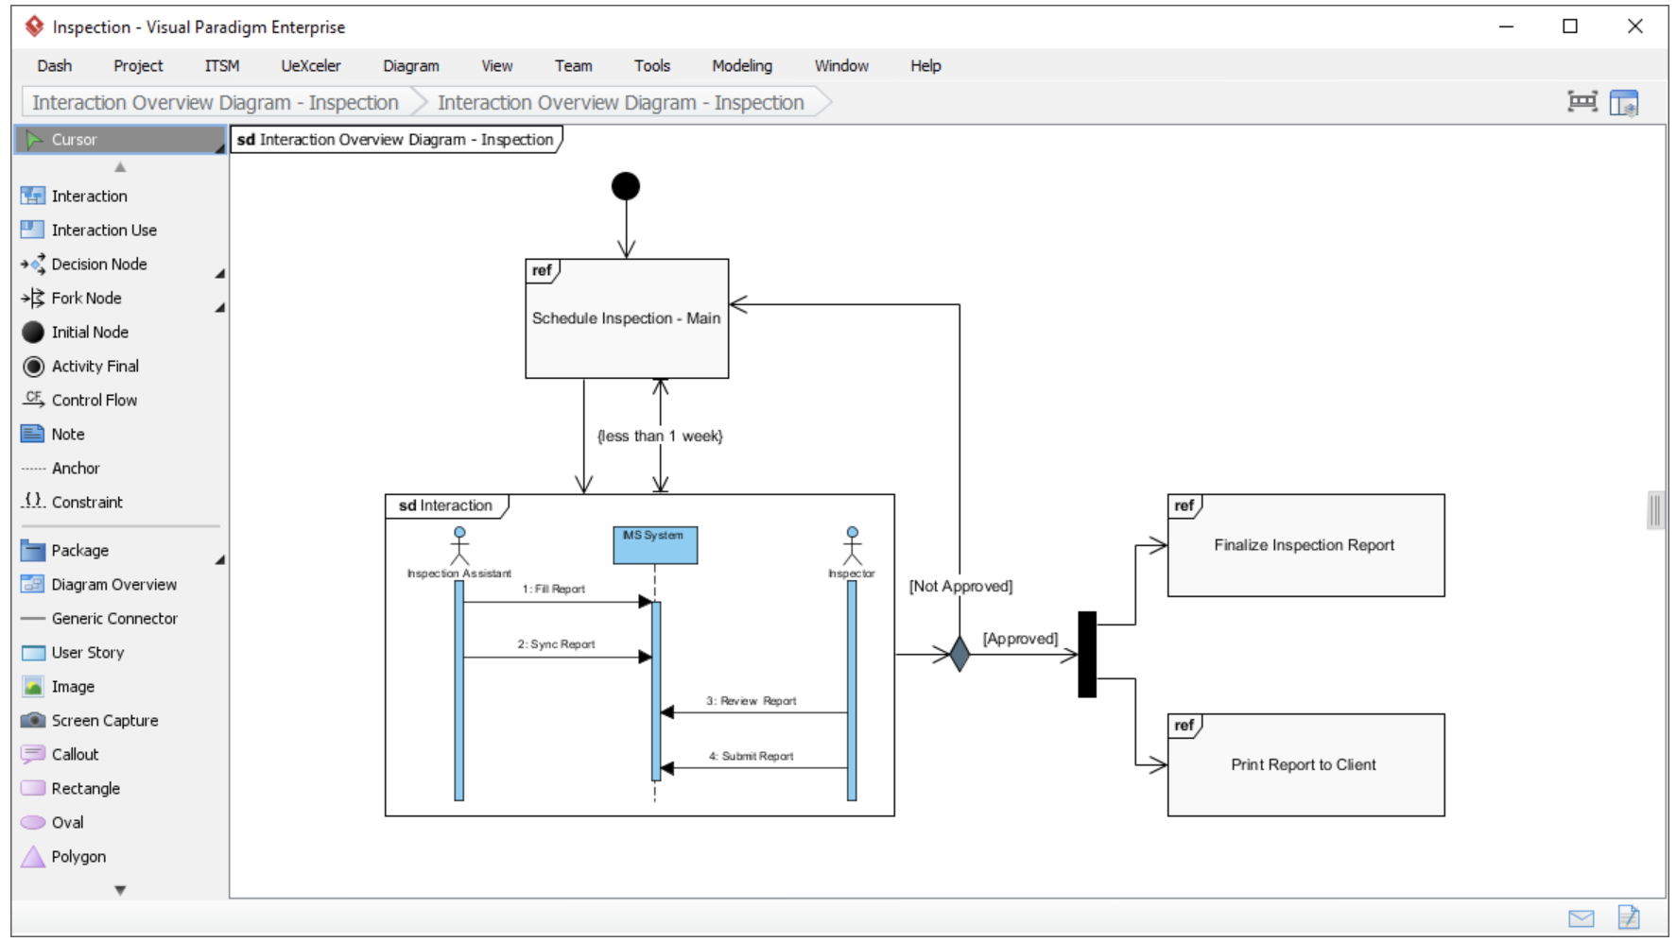
Interaction Overview Diagram View the sequence of interactions with UML interaction overview diagram. Interaction overview diagram helps represent complex scenario that involve multiple interactions presented as multiple UML sequence diagrams.

Slide 16
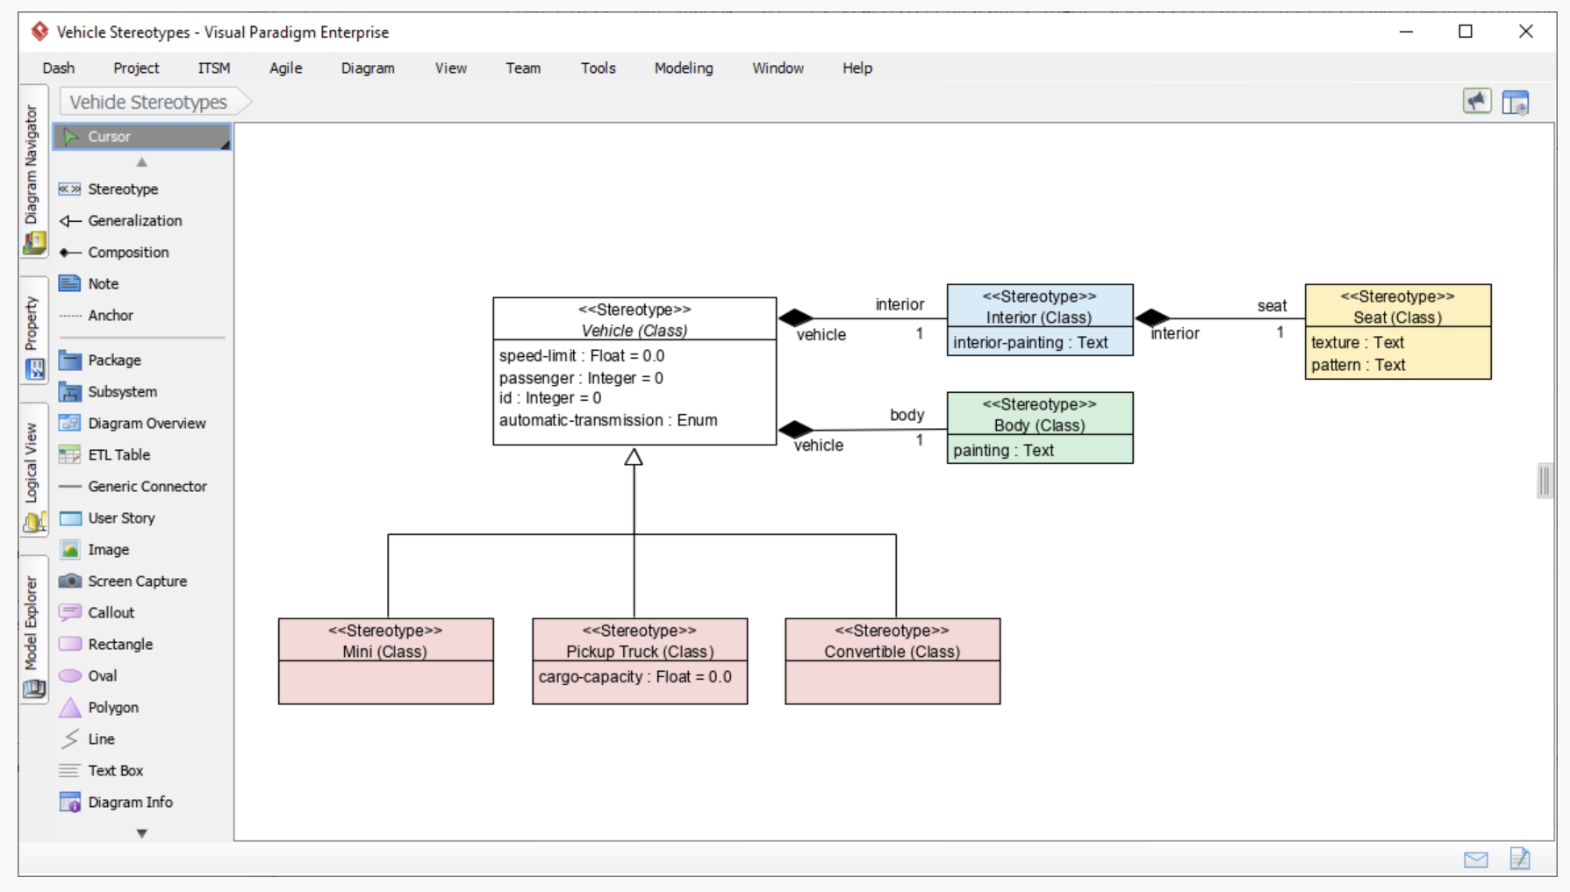
Profile diagram A visual way to define stereotypes to use in your project. Draw stereotypes, define their tags and their inter-relationships like generalizations and associations. Specify formatting options like background color and icons.

